Slide 1
Robot Design Animal Allies
Machines Inc., Team #5041

Slide 2
Team Members
Rohan Bommaraju aka Mr. Awesome, grade 7, likes football, karate, basketball, chess, friends, LEGO. Favorite phrase: “Touchdown”
Amrik Eadara aka Cam!, grade 7, likes math, writing, technology, robotics, basketball, football, baseball, karate, chess, legos. Favorite phrase: “Rush threw, redo”
Anish Patel aka Stud Muffin, grade 7, likes math, science, technology, programming, robotics, video games, baseball, karate. Favorite phrase: “In a minute!”
Vidhur aka Kid Genius, grade 6, likes hockey, soccer, football, EV3. Favorite phrase: “um uh um uh…”
Noah aka Dr. EZ, grade 7, likes

Slide 3
Robot Game Strategy
Mission No. | Mission Name | Mission Execution Order | Pts
0 | Pre-Start | Deer in animal conservation Calibration | 0 or 20
1 | Refrigerator | Get food from refrigerator | 0
2 | SharkCow | Shark tank pushed to left box; touching only tank floor Service dog mission Push cow Get bee Get pig to base; put prosthesis on pig | 27 + 15 + 0 + 0 + 15= 57
3 | Food Drop Off | Feed gorilla Feed bat Feed bird Feed frogs Gecko on wall Zoologist in training and research area Panda release | 20 + 20 + 20 + 20 + 15 + 15 + 10 - 6= 114
4 | Milking Automation | Milking automation Dog and Trainer in box + 1 manure 2 manures, 1 at a time | 20 + 17 + 10 = 47
 | THE END | Possible Score: 218 or 238

Slide 4
What We learned
We found a bug with wait block. When robot moving forward and looking to detect reflective intensity, white or black, the robot must call the stop block even if it is looking to move forward certain distance after reflective intensity detection. If it does not stop, the rest of the program will work inconsistently.
We learned about trigonometry, SOH-CAH-TOA, right triangles, and pythagorean theorem. We want to first rotate and then go straight for certain distance. After rotating certain degrees, if the rotation is off by 1 degree, the robot will miss its target after going straight by more than half inch. We calculated the target offset by using the formula: distance * tangent(actual degrees - target degrees). For example, if we want to turn 90 degrees and go straight 30 inches, the error will be 0.5 inches if robot turns 91 degrees. Formula: 30 * tangent (91 - 90) = 0.524 inches
When programming, we didn’t know how to follow a line with one color sensor. We did lots of research, read lots of books, and programmed tests to learn about line following. After many tries, we looked at an interesting book, “Winning Designs!”, and learned about using multiple sensors and different programs for line following. At the end, we decided to use the right sensor and proportional line follower for line following for accuracy and to free up the left color sensor for other tasks.
We also learned that when you use the gyro for turning, it is not very accurate and always overshoots. We also learned the robot has to wait for gyro to catch up. But then, we noticed that when the robot goes slow it is very precise. Therefore, we made a block that makes the robot go at a very high speed at first. This will cause robot to overshoot but then it slowly adjusts to desired value after gyro catch up. Wait for 0.25 seconds.
We thought we could also use the gyro to go straight because when you use the move steering to go straight, the robot drifts to the right. We call this block the “gLineBlock”. It is the motor value plus or minus the error. The error is the actual (0°, robot going straight) minus the sensor value times the gain. The gain is the reaction time. This formula makes the robot go straight using gyro and move steering block.
Touch sensor - We thought that using touch sensors would make the robot be more accurate. We figured that that you could make the touch sensor line up with the wall. If you use the touch sensor, it would be more accurate.

Slide 5
What We learned (cont.)
Food dispenser block - Automatically dispenses the food that was put in the dispenser at the beginning. In the block, you can input the amount of times each food is pushed out. Solution is a simple medium motor rotation back and forth.
Line Align Block - Using line align would make the robot straight because if you have two color sensors that lines up with a straight line, the robot will be precise. We made it so that if the left sensor senses the line before the right sensor does, the right wheel moves until the right sensor does. It is the same thing with the other side. If the right sensor senses the line before the left sensor does, the left wheel moves until the left sensor does.
Using combination of sensors, wall and mat lines to position and navigate the robot – angles and parallel lines
Gyro Display Block – We noticed that the gyro kept drifting. Therefore, we made a drift detection program. It shows the display for the gyro on the screen of the robot. If the gyro isn’t equal to 0° (not straight), it makes a beeping noise. If the gyro drifts, the robot would not go straight because we have another block that makes the robot go straight using the gyro.
Color Calibration Block– This block calibrates the 2 color sensors. When the robot is in a different room or the robot is just turned on, you would do the calibration. Before we created this, the robot didn’t see the line. To calibrate the robot, you just have to put the color sensor over the color the robot says. For example, If the robot says “White”, You would put the color sensor over white, but if the robot says “black”, you would put the color sensors on the black line.
Sequencer Block – This program sequences all the programs in mission order. You would press the right button to go to the next program and you would press the left button to go to the previous program. And the sequence loops when incrementing at max value or decrementing at minimum value.

Slide 6
MyBlocks
gTurnBlock – Uses gyro feedback for accurate wide turns and uses only one wheel to turn. Block inputs: left or right turn, degrees to turn. The formula used for this block is: Turn right or left at specified power for specified degree. This will result in the robot overshooting. Wait for a 0.25 seconds delay for the gyro to catch up. After that, the robot slowly adjusts, until specified degrees.
Proportional Line Follower - Uses the right color sensor to follow a black line. If the right color sensor senses more white than black, the robot turns left and when the color sensor senses more black than white, the robot turns right. The formula is the power - (reflected light intensity ± inputted reflected intensity * (gain -> 0.2)) = power of motor B/power of motor c (that is what the ± is for).
gSpinBlock – This block uses gyro feedback to make short or spin turns while using both wheels turning in opposite directions. Block inputs: degrees to turn. The formula used for this block is: After the robot turns the specified amount of degrees, there is a 0.25 seconds delay. After that, the robot slowly adjusts, until specified degrees.
gLineBlock – Uses gyro feedback to go straight. Robot automatically adjusts Power_A or Power_B through move steering if gyro ≠ 0. Inputs: length, power, wheel diameter. Using the formula: (length * 360) / wheel_circumference, the robot decides if the amount of inches is positive or negative. If it is positive, the formula is 0-gVal=power. If it is negative, the formula is gVal=power.
LineCounter – Use right color sensor to count number of lines passed. Useful for navigation to get to specific zone area on field mat where distance between two points can vary. LineCounter is an alternative to measuring fixed distance in inches for navigation.
WallAlign – This block aligns with the wall for a certain amount of specified time.

Slide 7
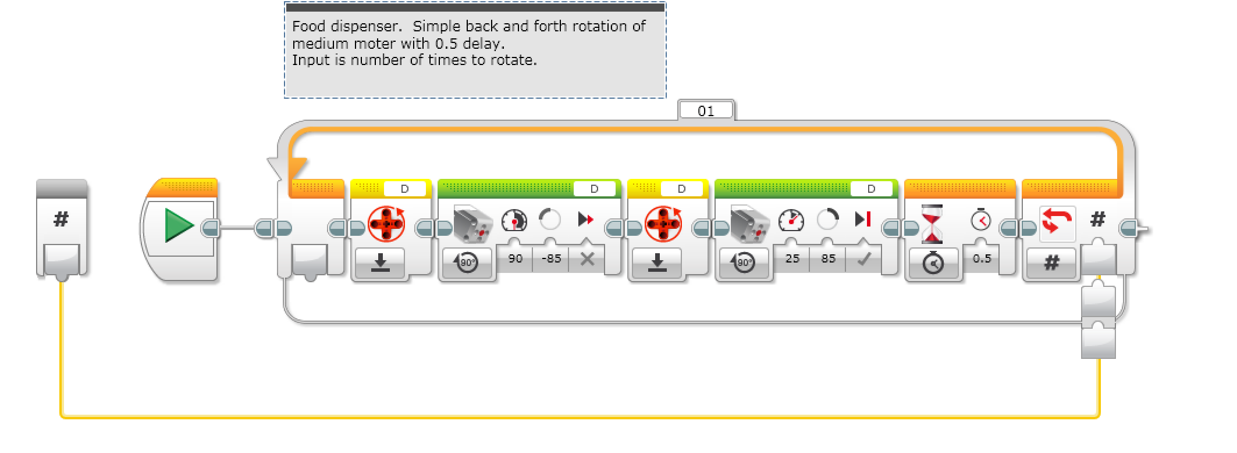
Food Dispenser Block

Slide 8
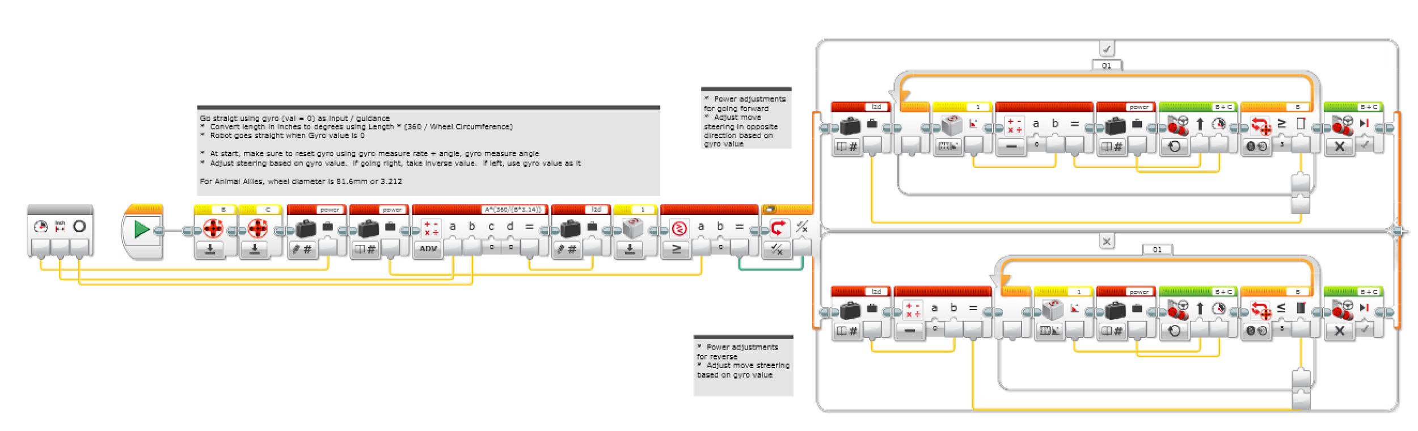
gTurnBlock Block

Slide 9
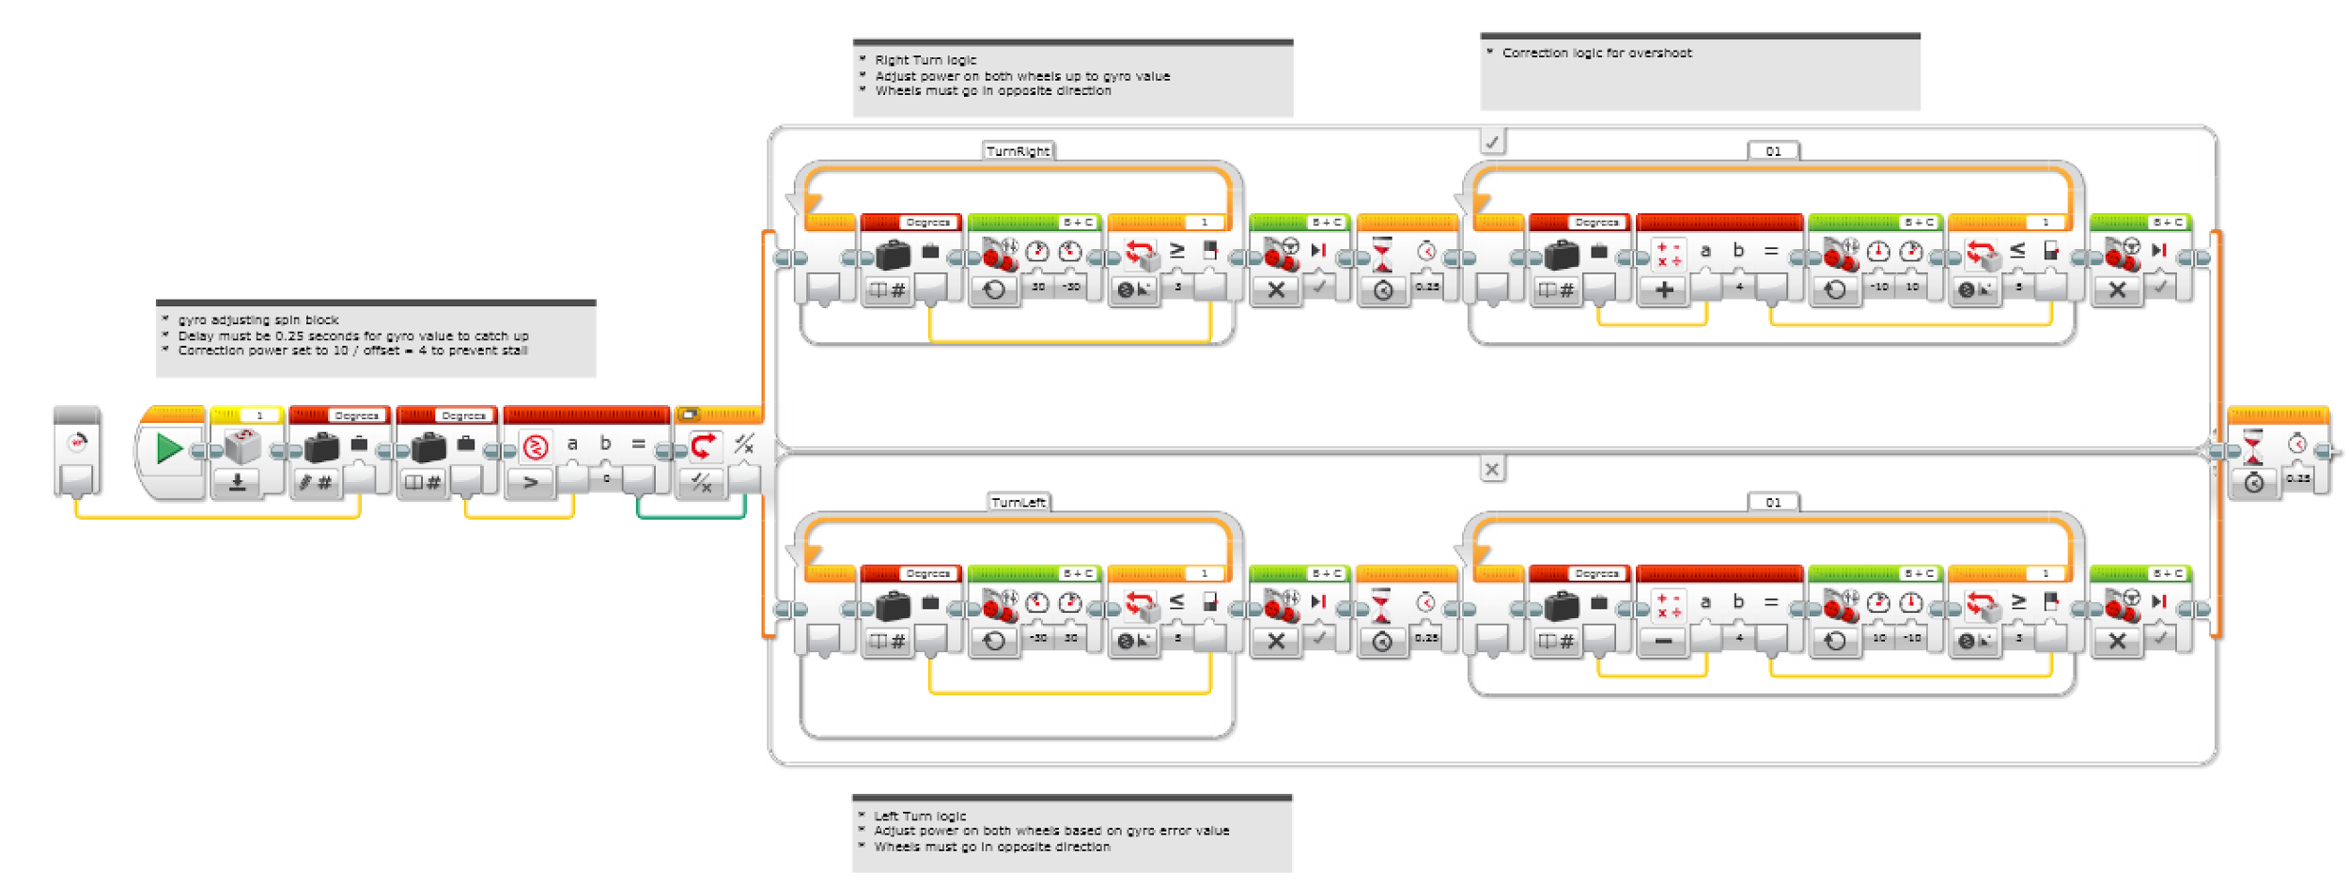
gSpinBlock Block

Slide 10
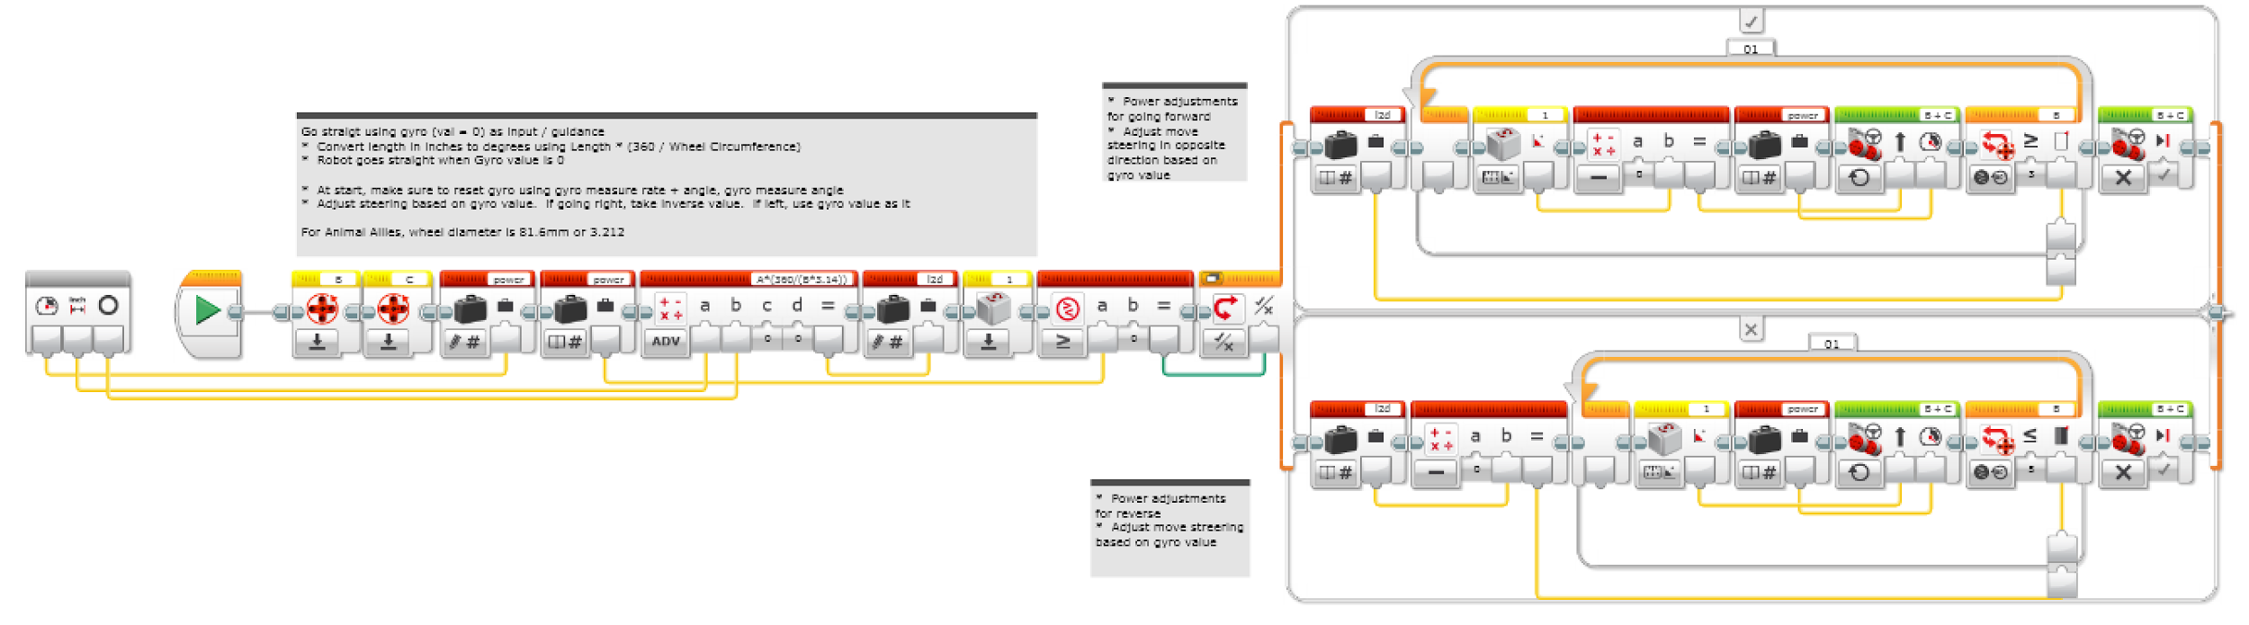
gLineBlock Block

Slide 11
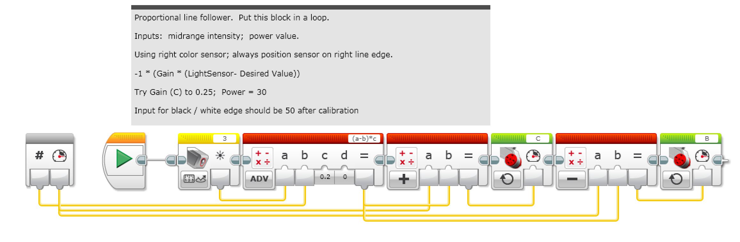
Proportional Line Follower

Slide 12
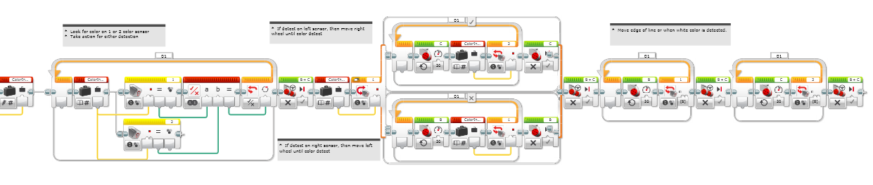
LineAlign Block

Slide 13
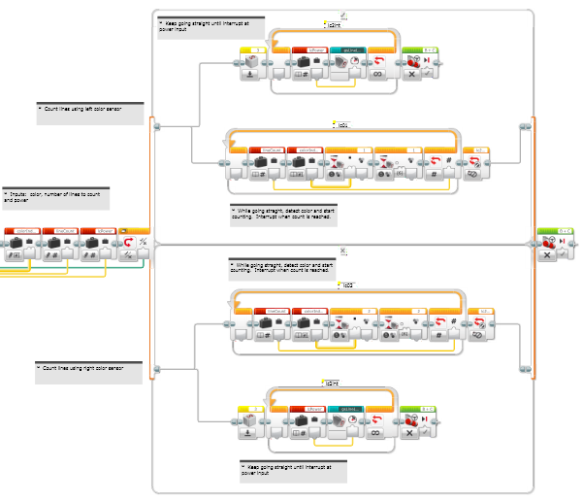
LineCounter Block

Slide 14
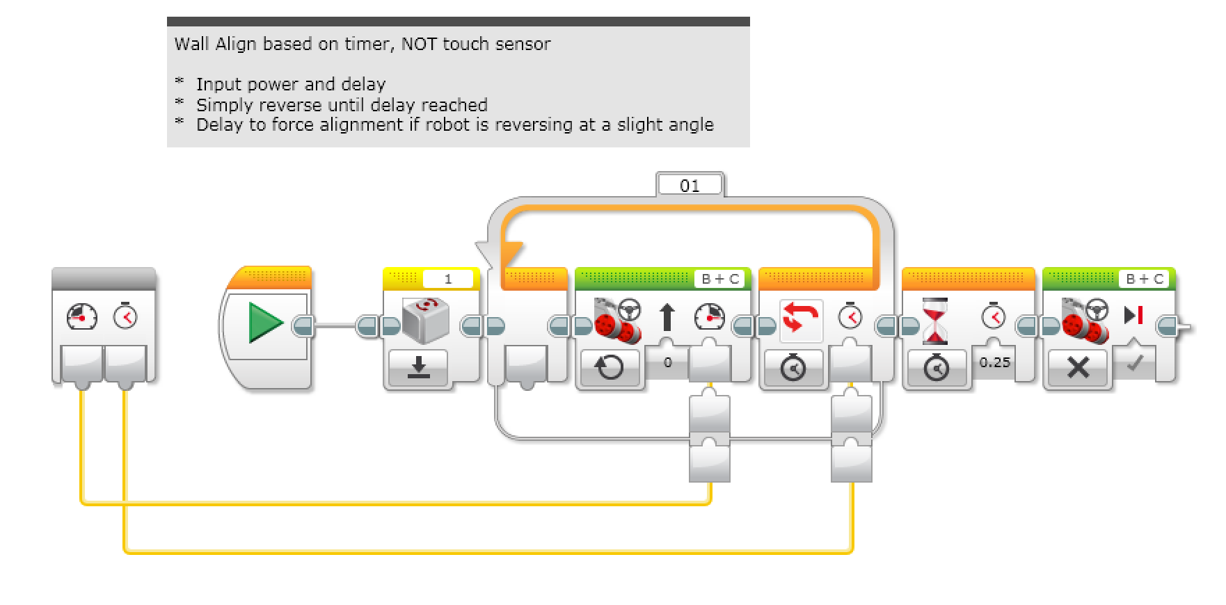
WallAlign Block

Slide 15
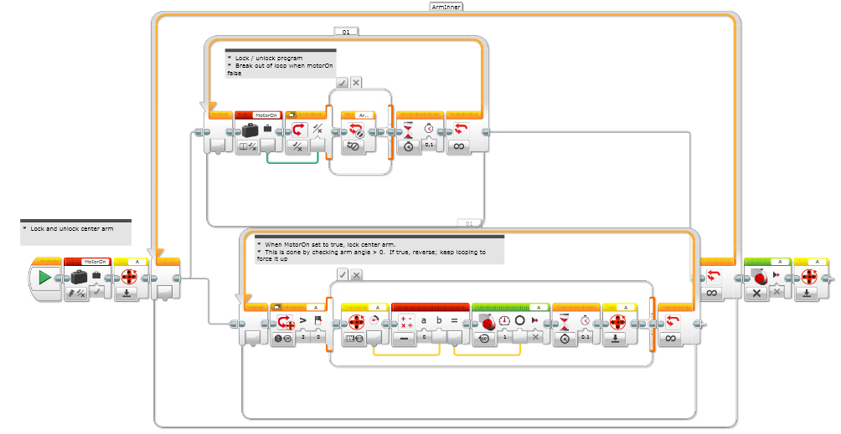
ArmLockBlock

Slide 16
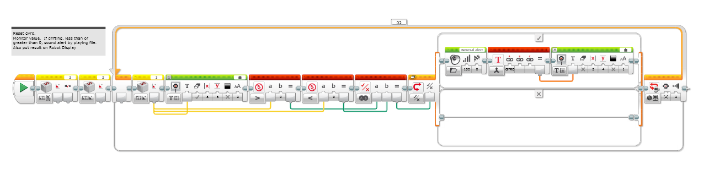
Gyro Display Block

Slide 17
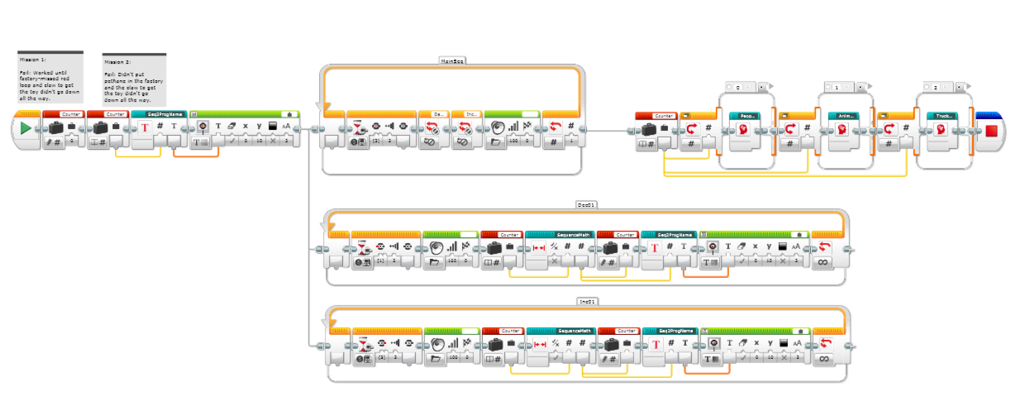
Sequencer

Slide 18
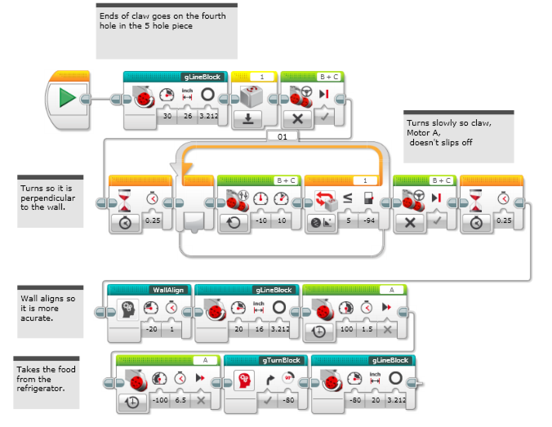
Mission 1: Refrigerator

Slide 19
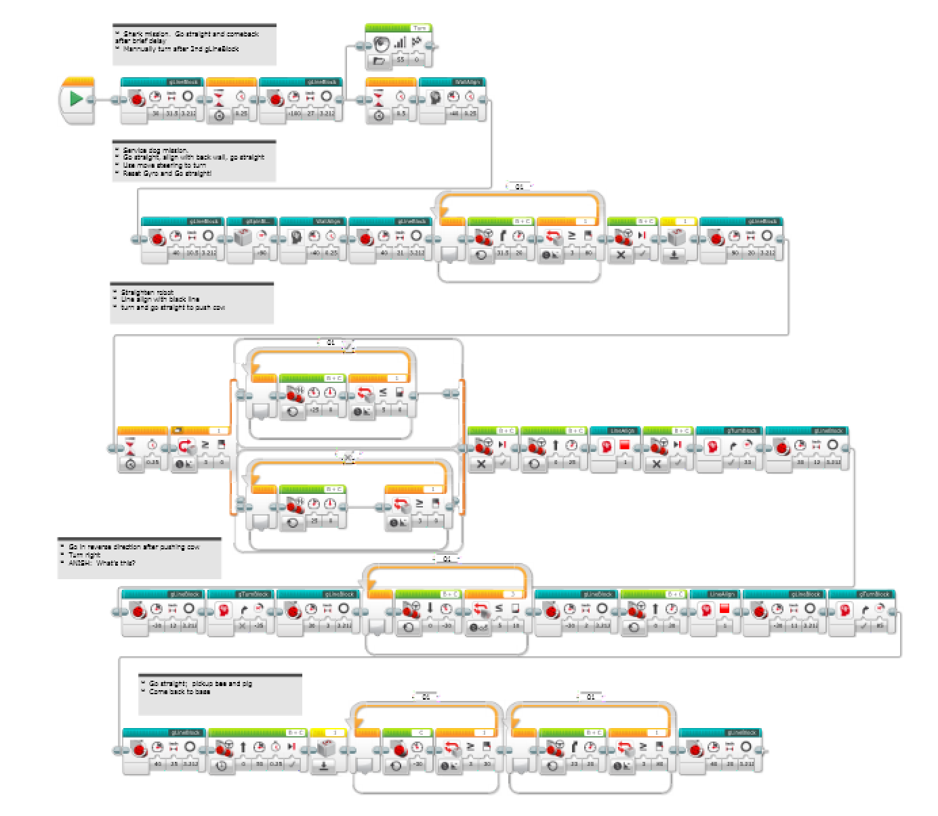
Mission 2: Shark + Cow

Slide 20
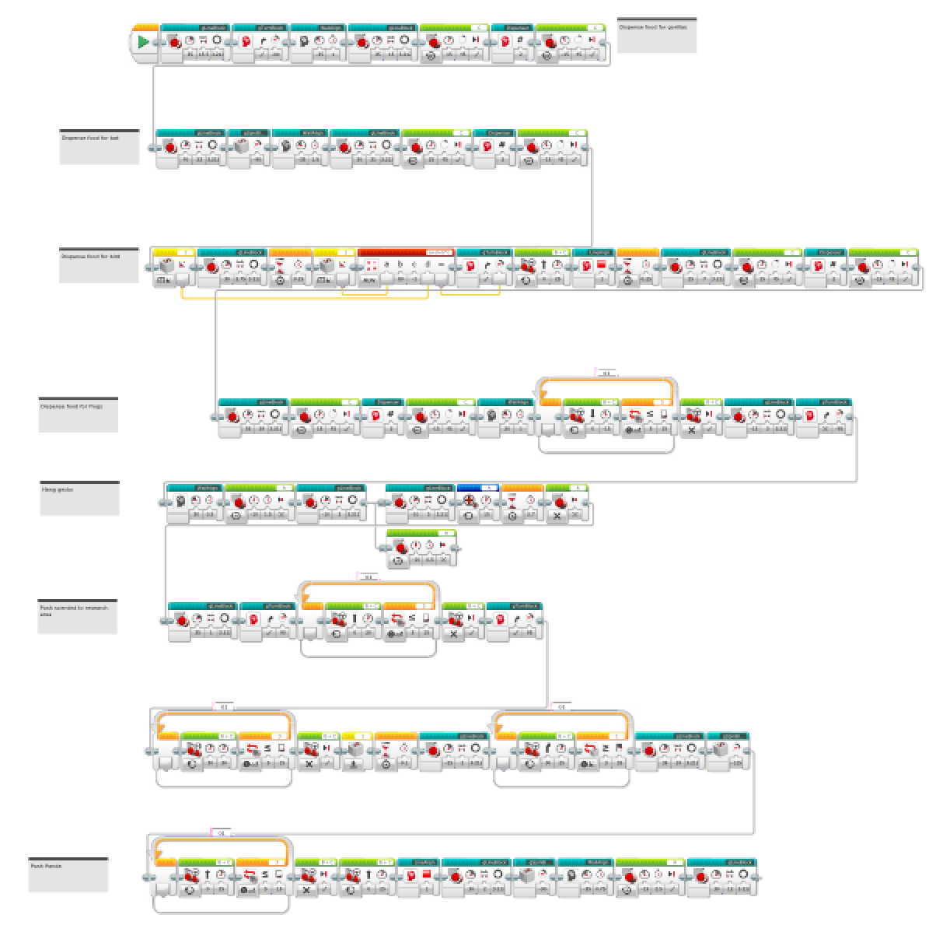
Mission 3: Food Drop

Slide 21
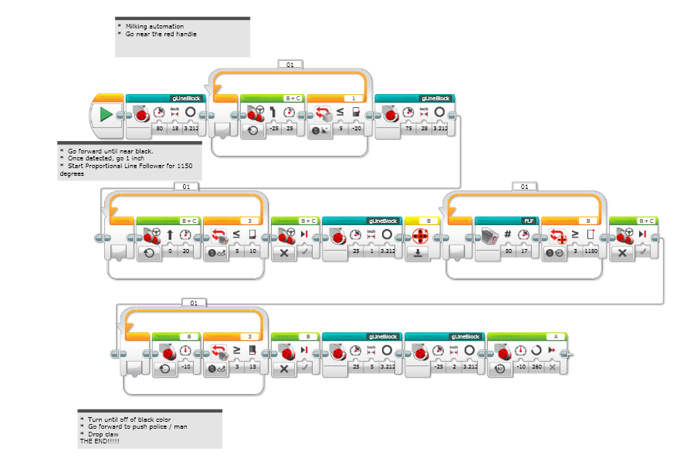
Final Mission 4: Milking Automation

Slide 22
Score Sheets: Refrigerator
Run Number | Time | Pass / Fail | Failure Point | Fix | Points
1 | 19.58 | Pass |  |  | 0
2 | 19.51 | Pass |  |  | 0
3 | 19.94 | Pass |  |  | 0
4 | 19.11 | Pass |  |  | 0
5 | 18.89 | Pass |  |  | 0
6 | 19.17 | Pass |  |  | 0
7 | 19.66 | Pass |  |  | 0
8 | 19.59 | Pass |  |  | 0
9 | 19.87 | Pass |  |  | 0
10 | 18.83 | Pass |  |  | 0
AVG: | 19.415 sec |  |  |  | 0 Pts

Slide 23
Score Sheets: SharkCow
Run Number | Time (Seconds) | Pass / Fail | Failure Point | Fix | Points
1 | 37.73 | Pass |  |  | 57
2 | 36.52 | Pass |  |  | 57
3 | 36.58 | Pass |  |  | 57
4 | 36.12 | Pass |  |  | 57
5 | 36.13 | Pass |  |  | 57
6 | 36.54 | Pass |  |  | 57
7 | 31.23 | Pass |  |  | 57
8 | 32.52 | Pass |  |  | 57
9 | 36.34 | Pass |  |  | 57
10 | 36.12 | Pass |  |  | 57
AVG: | 35.583 sec |  |  |  | 57

Slide 24
Score Sheets: Food Drop
Run Number | Time (Seconds) | Pass / Fail | Failure Point | Fix | Points
1 | 75 | Pass |  |  | 89
2 | 72 | Pass |  |  | 89
3 | 72 | Pass |  |  | 89
4 | 73 | Pass |  |  | 89
5 | 67 | Pass |  |  | 89
6 | 76 | Pass |  |  | 89
7 | 72 | Pass |  |  | 89
8 | 75 | Pass |  |  | 89
9 | 75 | Pass |  |  | 89
10 | 74 | Pass |  |  | 89
AVG | 73.10 |  |  |  | 89

Slide 25
Score Sheets: Milking Automation
Run Number | Time (Seconds) | Pass / Fail | Failure Point | Fix | Points
1 | 15 | Pass |  |  | 47
2 | 16 | Pass |  |  | 47
3 | 16 | Fail | Crashed into cow | Retry | 30
4 | 17 | Pass |  |  | 47
5 | 17 | Pass |  |  | 47
6 | 17 | Pass |  |  | 47
7 | 16 | Pass |  |  | 47
8 | 16 | Pass |  |  | 47
9 | 16 | Pass |  |  | 47
10 | 16 | Pass |  |  | 47
AVG | 16.20 |  |  |  | 47

